Slide 1
Agile Session
Sreeram Murty ( PMP, CSM, CSPO)
Date : 19/07/2018

Slide 2
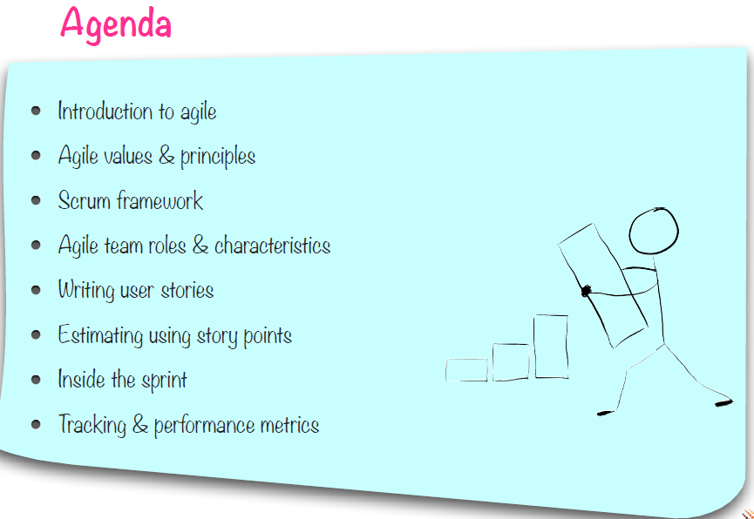

Slide 3
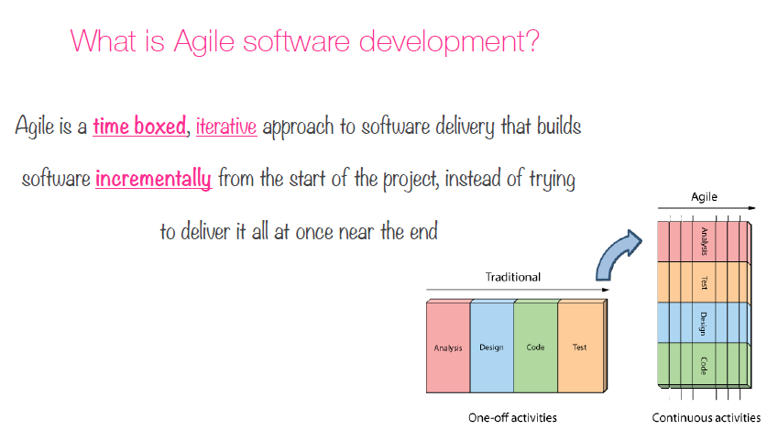

Slide 4
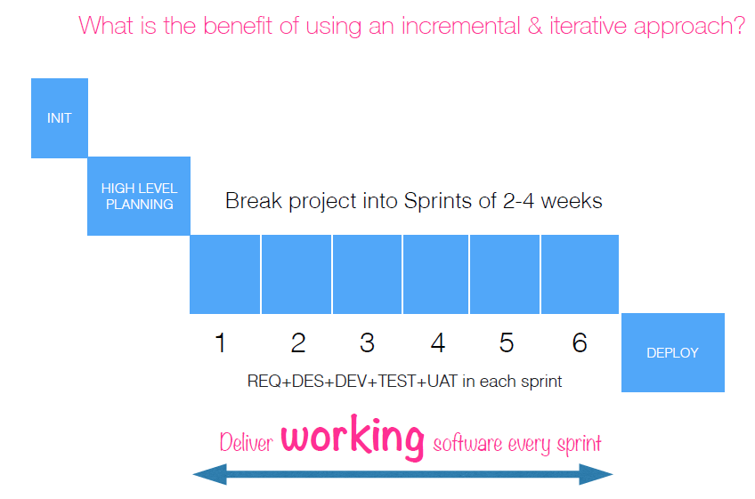

Slide 5
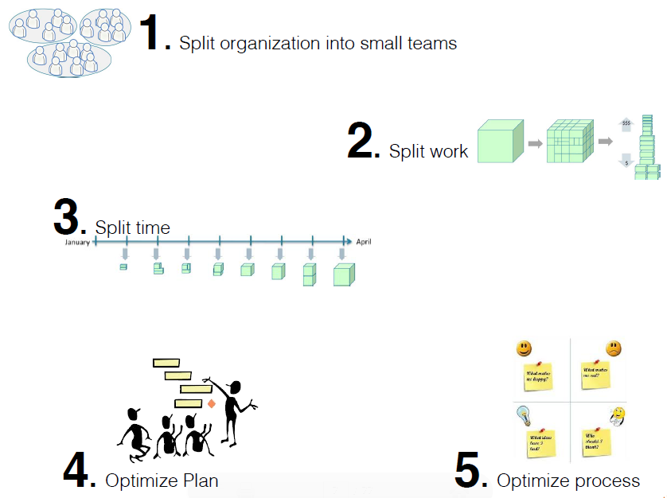

Slide 6
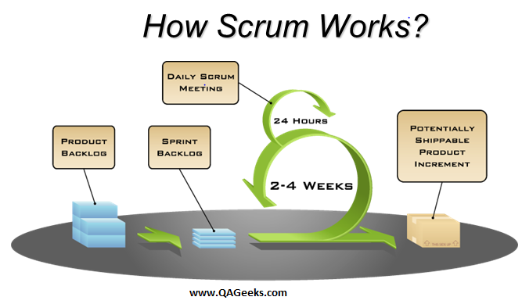
How Scrum works?

Slide 7
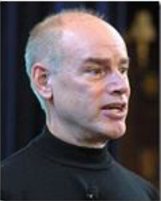
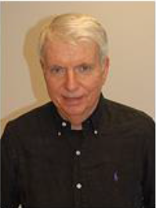
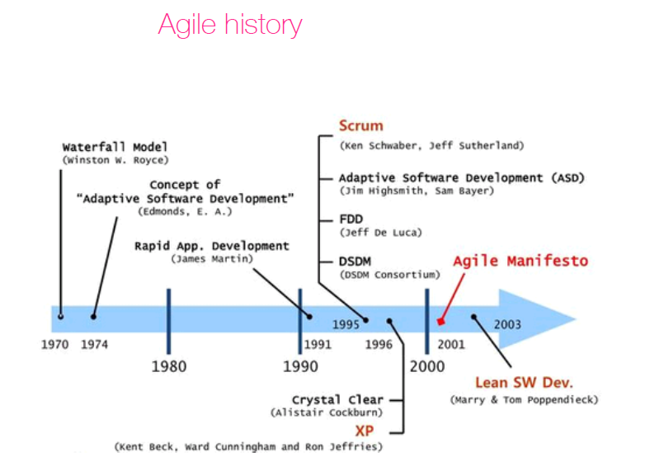

Slide 8


Slide 9


Slide 10
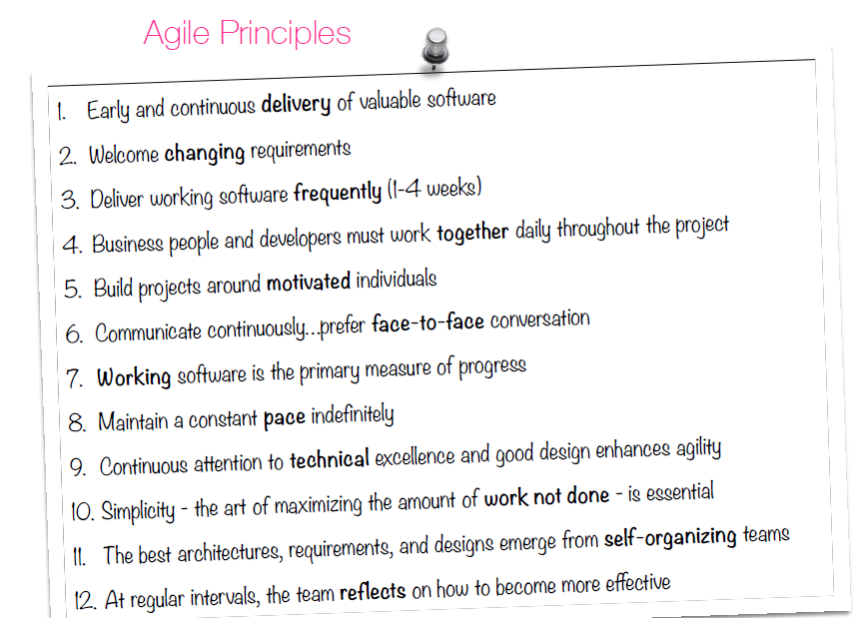

Slide 11


Slide 12
Three Pillars of Scrum
Transparency
Significant aspects of the process must be visible to those responsible for the outcome. Transparency requires those aspects be defined by a common standard so observers share a common understanding of what is being seen.
For example:
- A common language referring to the process must be shared by all participants; and,
- Those performing the work and those accepting the work product must share a common definition of “Done”.
Inspection
Scrum users must frequently inspect Scrum artifacts and progress toward a Sprint Goal to detect undesirable variances. Their inspection should not be so frequent that inspection gets in the way of the work. Inspections are most beneficial when diligently performed by skilled inspectors at the point of work.
Adaptation
If an inspector determines that one or more aspects of a process deviate outside acceptable limits, and that the resulting product will be unacceptable, the process or the material being processed must be adjusted. An adjustment must be made as soon as possible to minimize further deviation.
Scrum prescribes four formal events for inspection and adaptation, as described in the Scrum Events section of this document:
Sprint Planning
Daily Scrum
Sprint Review
Sprint Retrospective

Slide 13
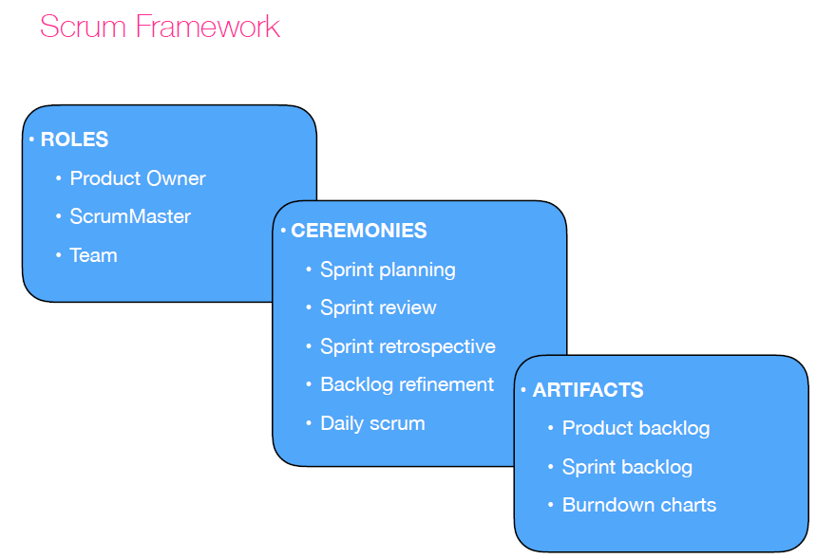

Slide 14
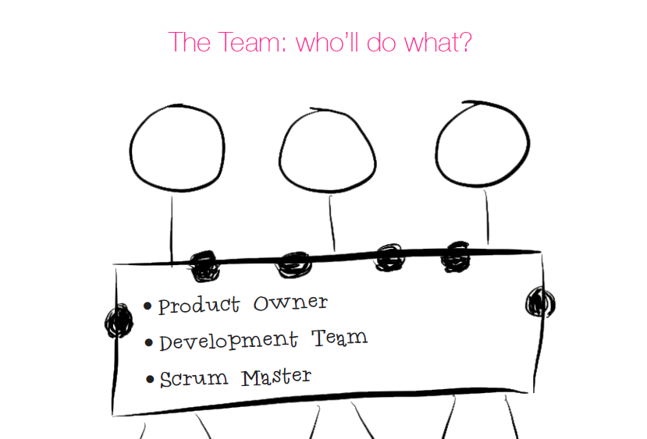

Slide 15
Product Owner
I define the features of the product
I ‘m responsible for optimizing the business value and ROI
I create, prioritize and maintain the Product
Backlog and organize it into incremental releases
I review the work done by the team to ensure that its done as per acceptance criteria
I demonstrate the product to stakeholders and evaluate the product for release readiness

Slide 16
Development Team
We understand and commit to Sprint goal and create Sprint Backlog
We convert Product Backlog into product increment, help each other and self-organize to achieve the committed sprint goal
We demonstrate the work done to stakeholders and understand their
feedback
We meet on daily basis to see how things are progressing and adapt to situation
Our focus is technical excellence and engineering practices

Slide 17
The Scrum Master
I’m responsible for enacting scrum values and practices
I help the PO in defining, prioritizing and maintaining the Product Backlog
I facilitate the Sprint planing meeting and help team to create Sprint Backlog and a goal
I help team to inspect and adapt based on feedback from previous sprints
I coach team to self-organise and help them solve impediments
I remove impediments and escalate when needed

Slide 18
Team Charecterestics
The team size is typically 5-9 people
Cross-functional
Everyone has a say
Co-located
Stability
Committed
Focussed

Slide 19
Scrum artifacts –
Product backlog -
The Product backlog is a set of all baseline requirements prioritized in order which is made available by the Product Owner to the Scrum Team. The product backlog emerges and evolves over time and the Product Owner is responsible for its content and validity.
Sprint backlog -
The Sprint Backlog is a subset of the Product Backlog that the team pulls into the sprint to work on. It is essentially the list of “To Do’s” a development team might be working during the current sprint.
Product increment -
The most important Scrum artifact is the Product Increment. Each Sprint the development team produces potentially shippable product increment. This product increment must align to the development team’s “Definition of Done” and this increment must be acceptable by the Product Owner.

Slide 20
Scrum ceremonies –
Sprint planning meeting
Timebox: Eight hours for a four-week sprint, proportionately shorter for shorter sprints Attendees: The complete Scrum team, including all roles Most important: Team capacity and DoD (Definition of Done)
Daily Scrum
Timebox: Fifteen minutes is standard, irrespective of the duration of the sprint length Attendees: The complete Scrum team, including all roles Most important: To speak about any impediments Sprint review meeting
Timebox: Four hours for a four-week sprint, proportionately shorter for shorter sprints Attendees: The complete Scrum team, including all roles, plus any other stakeholders who are interested in the project success Most important: Demo of working software and assessing the feedback
Sprint retrospective meeting
Timebox: Three hours for a four-week sprint, proportionately shorter for shorter sprints Attendees: The complete Scrum team, including all roles; the product owner's attendance is optional Most important: To brainstorm and agree on what is working and what is not

Slide 21
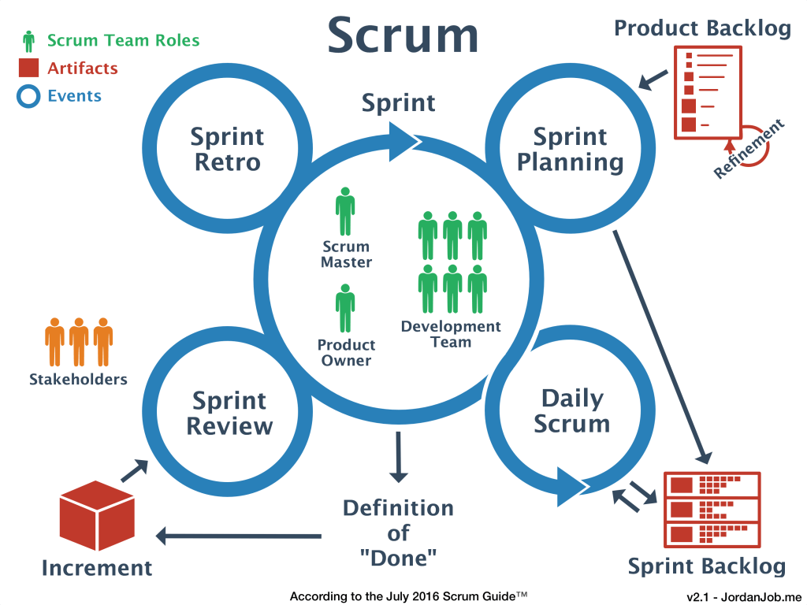

Slide 22
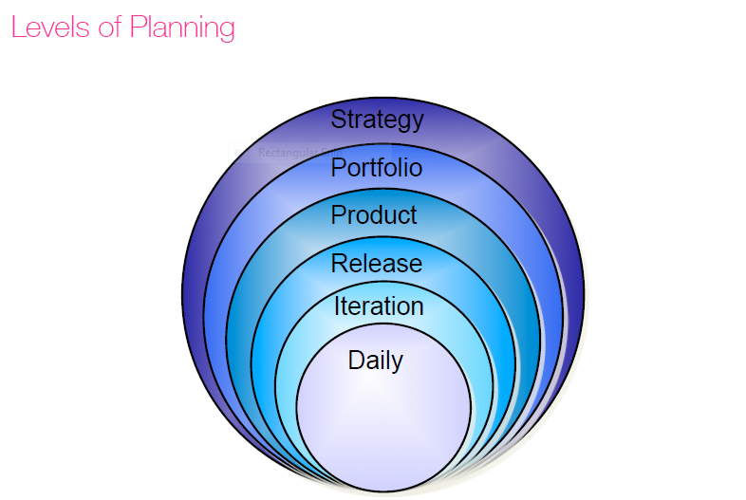

Slide 23
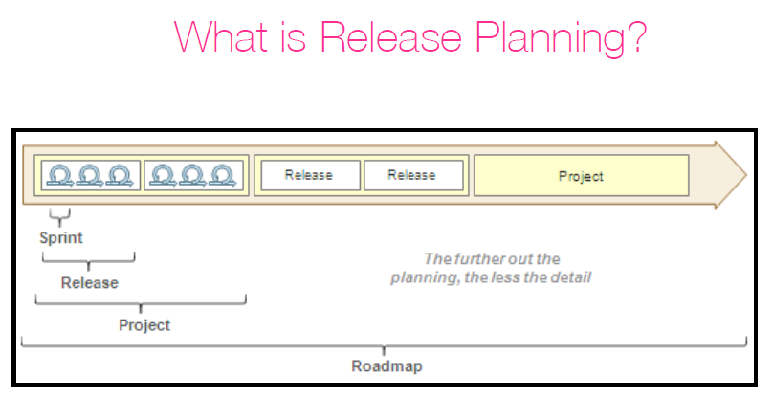

Slide 24
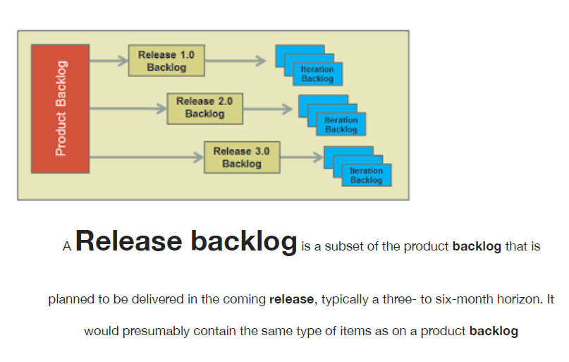

Slide 25
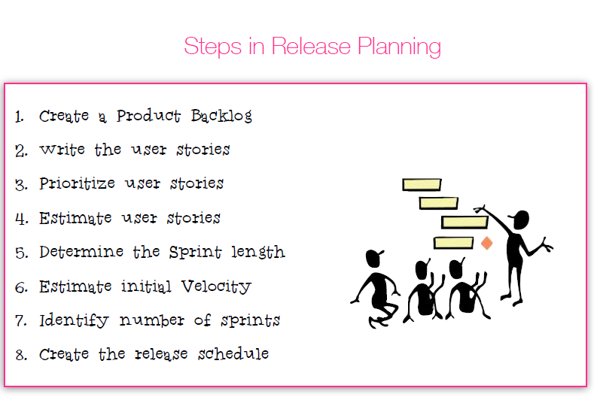

Slide 26
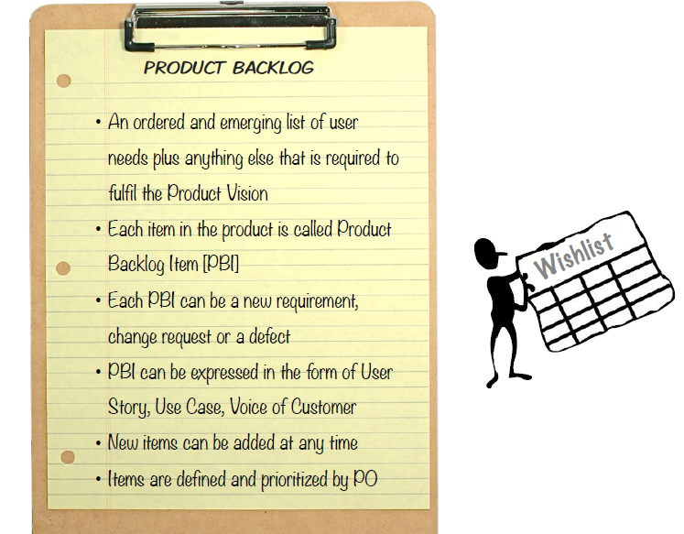

Slide 27
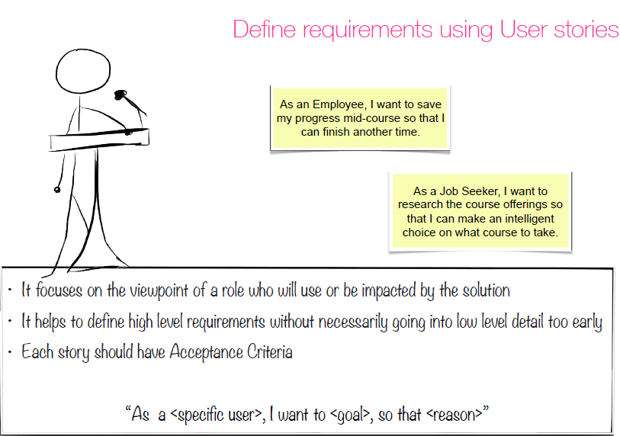

Slide 28
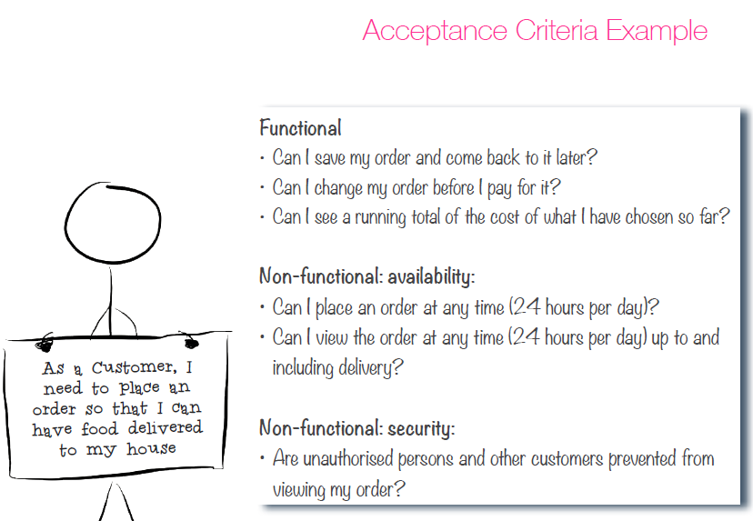

Slide 29
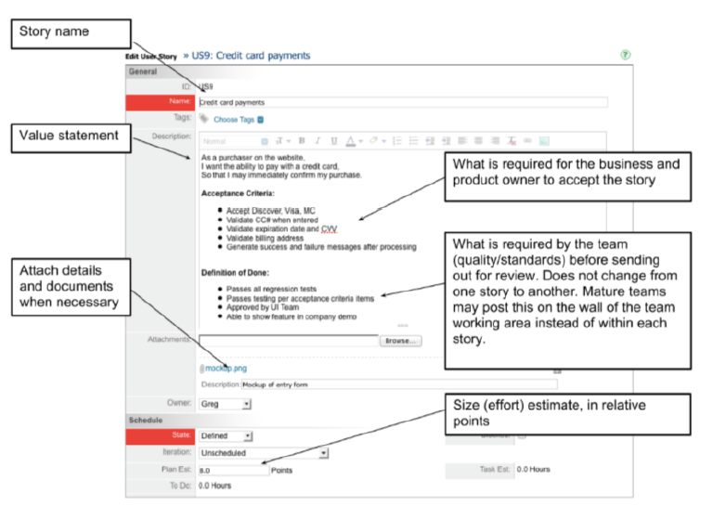

Slide 30
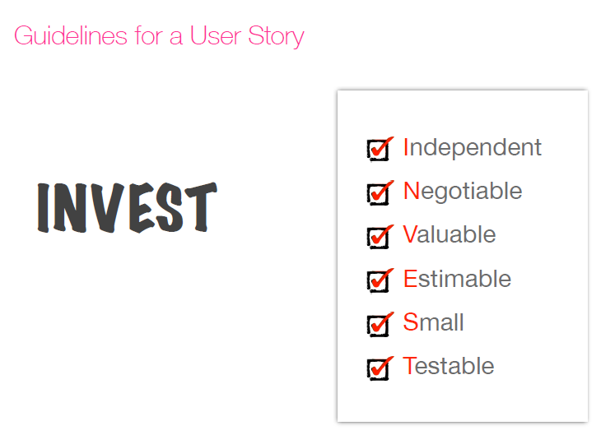

Slide 31
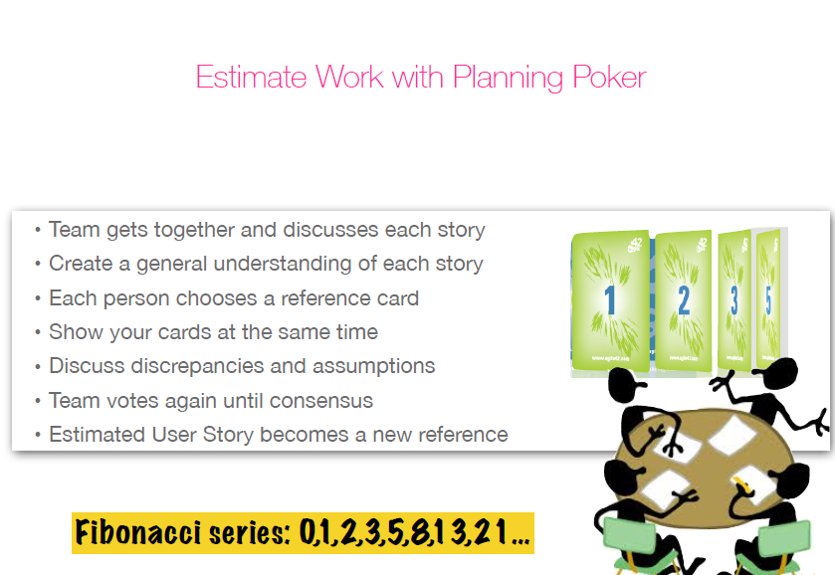

Slide 32
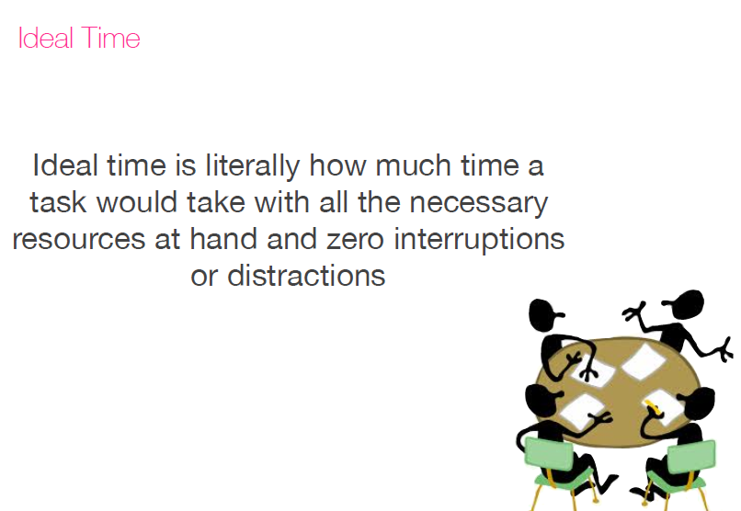

Slide 33
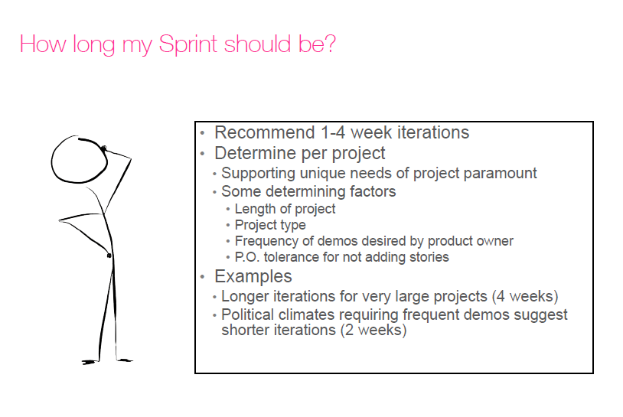

Slide 34
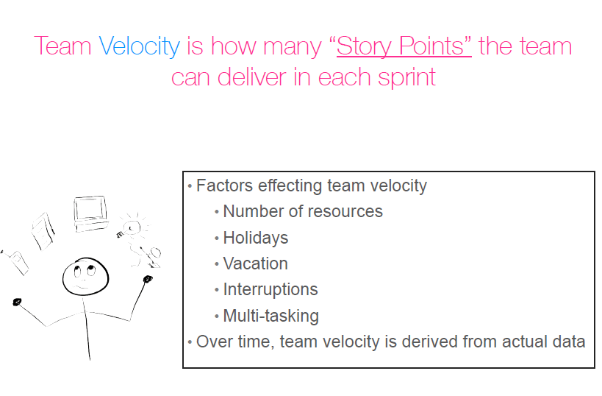

Slide 35
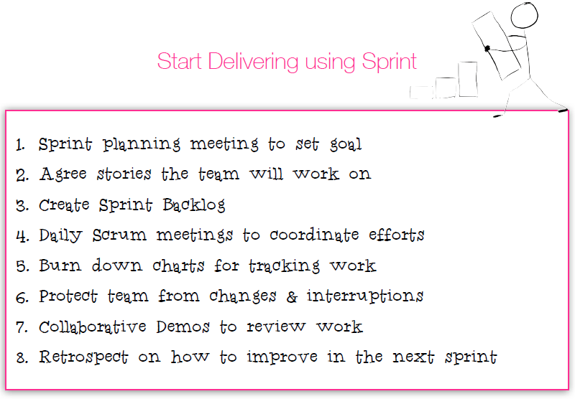

Slide 36
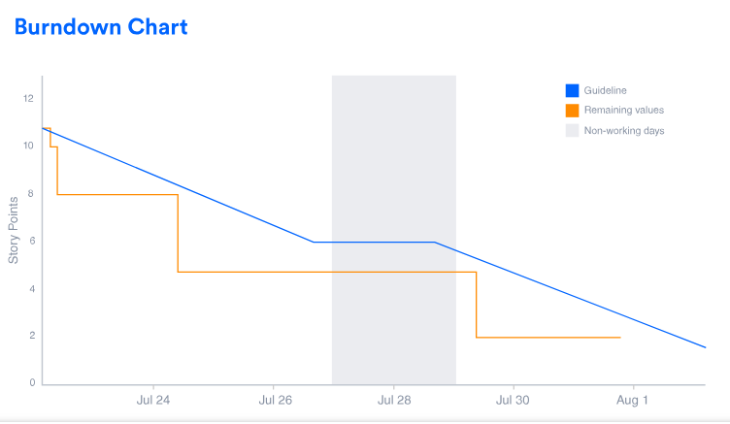
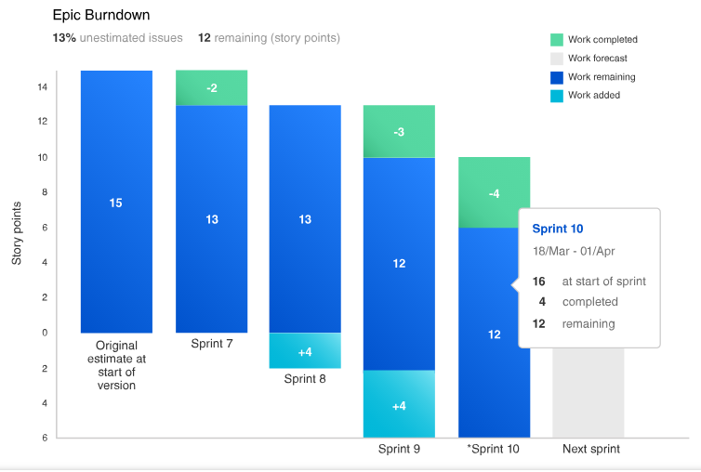
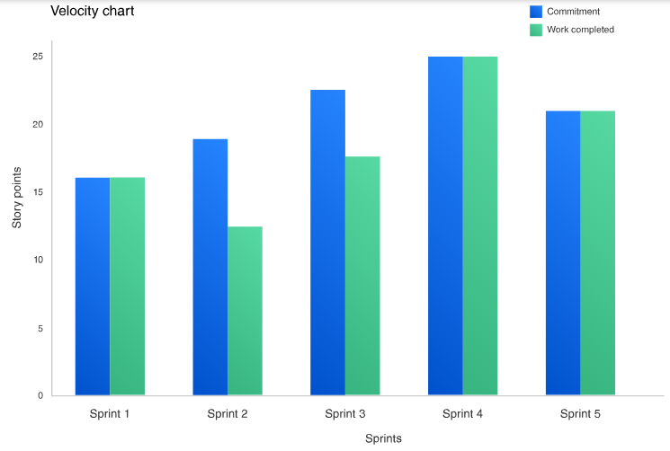
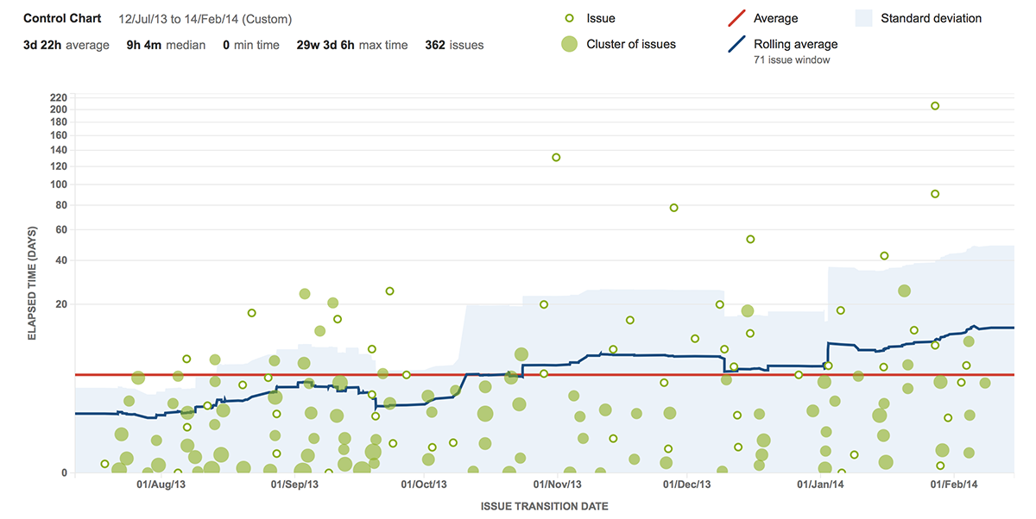
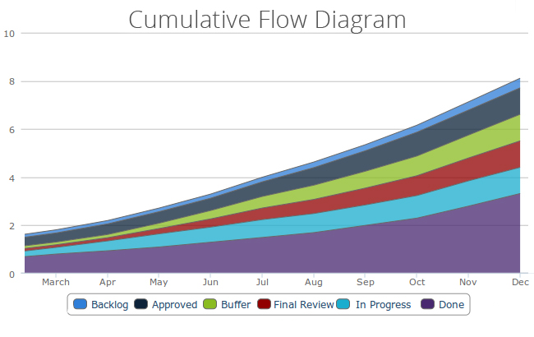
Agile metrics

Slide 37
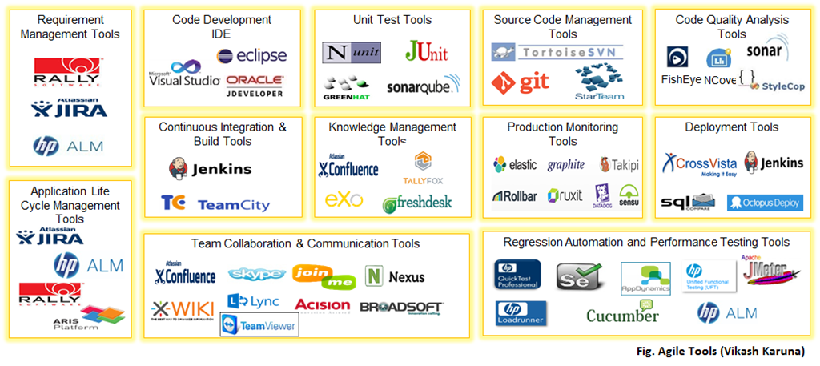
Agile tools

